Slide 1
Sports stats
Data Analysis Project

Slide 2
Content
Project Description
Questions
Hypothesis
Challenges
Outcome of Hypothesis

Slide 3
Project Description
This project intends to bring attention of all the trainers and sports analysts who want to find out insights from Olympics data which will help them know about the trends/patterns that have existed and evolved over the years.
Individual countries can also find about their history in the games and how that information can help them improving their focus on participation and plan strategies around it.

Slide 4
Questions
Has the gender difference remained consistent throughout the history of Olympics?
Did different seasons of Olympics have any impact on gender ratio and on participation?
Does the Sport with most participation gets a greater number of medals?
Has the number of games increased with the passing of each year?

Slide 5
Hypothesis
Male ratio to female would reduce but not much.
Seasons have no impact on gender ratio, but participation reduces in winters.
More participation in ‘X’ sport brings more medals in that sport.
Number of gaming events have increased.

Slide 6
Approach
Creating the tables with relevant parameters, and applying conditions to those parameters to find the desired, filtered data.
Looking out for meaningful information from that narrowed data to see the connections between the elements that help in projecting the facts.
Putting those facts to visualization which can easily be perceived by the audience and information can be observed.

Slide 7
Challenges
Figuring out the variables which would help in creating a new variable that can in turn help with further analysis.
Plotting a couple of graphs was challenging where the parameter was categorical in nature.

Slide 8
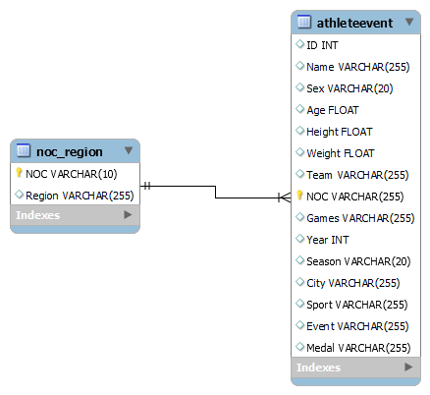
Entity Relational Diagram (ERD)

Slide 9
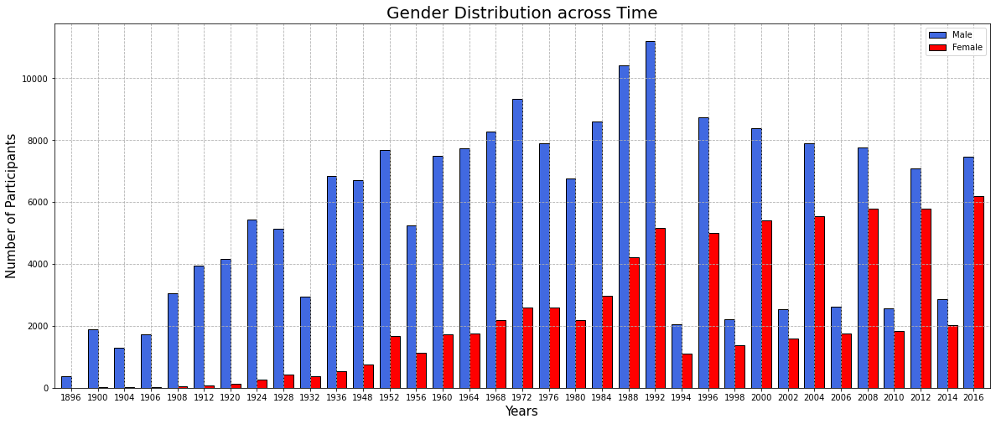
Gender Based Analysis
This graph shows that with gradual increase in time, participation of female players has increased many folds from the inception of the games.

Slide 10
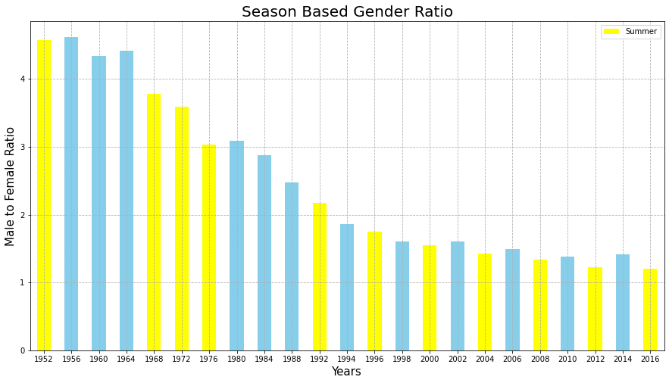
This graph shows that Male to Female ratio has been reducing with every successful passing games. The winter games (highlighted in Blue bars) have slightly higher gender ratio when compared to summer games. This concludes that seasons does have some impact on the gender ratio.

Slide 11
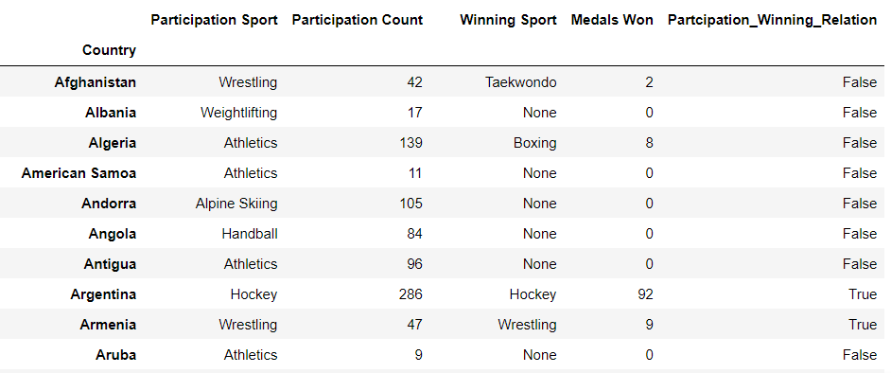
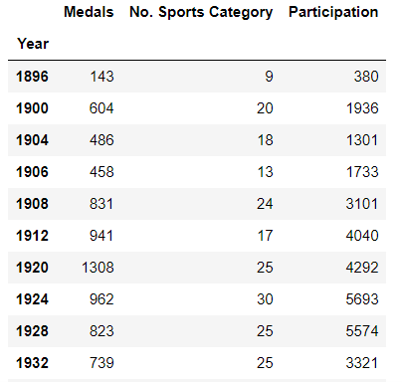
Left table explores the sport in which a country had their most participation versus the country with the sport which won most medals. And if there is any correlation between these parameters.
Right table analysis will draw out the medals won on yearly basis with number of participation based on Event/games organized under each category of sport.

Slide 12
Hypothesis Outcome
Gender ratio has drastically reduced, which as per the hypothesis made earlier, got proven wrong. It’s the quite opposite of what was initially thought of. From past three decades, the ration, on average has been 1.53.
‘Season Based Gender Ratio’ table/graph helps us interpret that be it any season, summer or winter, the gender-based participation is not highly impacted. In all we have seen that the gap between the gender ratio has been decreasing consistently. The above calculation helps us know that summer vs winter participation has had a difference of about 1000 participants on average. Summer has more count, but not a huge difference on a larger scale.
Theory of more participation being directly proportion to more medals, in case of same sport, has been debunked. The ‘outcome1’ table confirms that more participation in ‘X’ sport does not guarantee more medals in that sport. Out of total of 208 countries, about ¼ were only able to satisfy this hypothesis making it not at concrete path for the intended outcome.
In table 'participation_event_medal', the category of sports have increased with time, but in the recent decades, the winter sports category has reduced in numbers.

Slide 13
Beyond Descriptive Stats
Multiple parameters were quantified to find the correlation between those parameters.
Number of participants
Number of Events
Count of Medals
Pearson Correlation Coefficient has been calculated between these parameters to find out if there is any relationship between them .
Number of Participants & Number of Events = 0.95 Number of Participants & Count of Medals = 0.93 Number of Events & Count of Medals = 0.98
Correlation coefficient quantified from all the above mentioned relations came out to be highly positive. Therefore, we can ascertain that a country if sends more number of participants taking part in more number of events, they stand a chance of winning more medals.

Slide 14
Looking through the descriptive stats and other analysis throughout, we can gauge how some variables are so inter-linked with each other that they can establish a strong relationship between them.
Finding out different outcome for different parameters and how their result differs can assist many intended end-users figure out more about the situations which, on implementation or by modifying the current set criterias, can make a difference.
This indeed can assist stakeholders determine how the game’s history has been and how it can be different or same in future.

